Slide 1
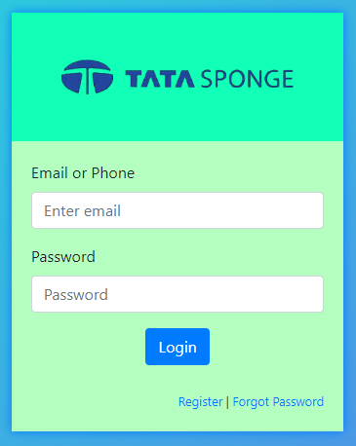
Carpool System
An Industrial visit at TATA Steel
(formally TATA Iron and Sponge Ltd )
Prashant Kumar Prasad
Pamela Banerjee
Under guidance of Mr Manoj Singh

Slide 2
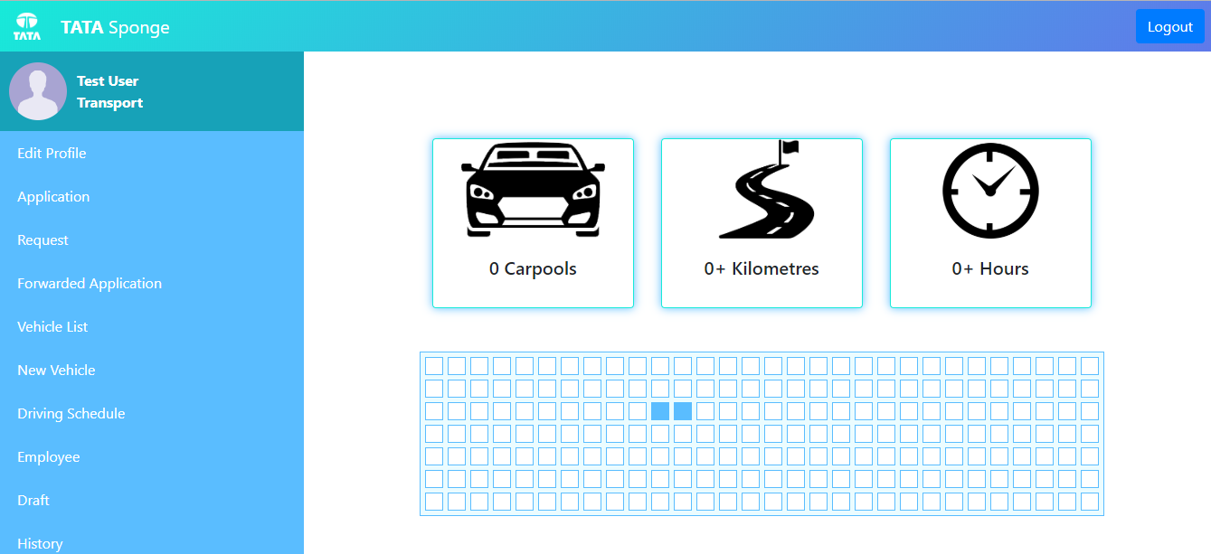
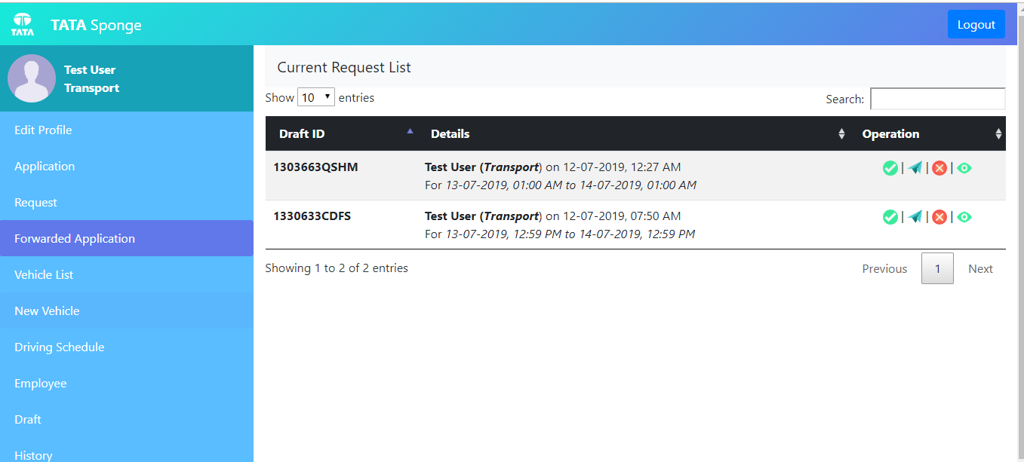
Problem Statement
The company want to design a web based internal system form where employee of company can apply for different kind off vehicle. The application will send to the respective manager of that employee. With the hierarchical model of management the first level of manager can forward that application to next level of manager till the top level of manager. In every level of management they have own authority to either accept that request of deny

Slide 3
User Level
Level 0 : Employee
Level 1 : Manager or Supervisor
Level 2 : Senior Manager
Level 3 : Head of department
Level 4 : Transport Head or Top Level Manager
Level 5 : System Admin

Slide 4





Dependency
Apache HTTP Server
PHP
SQL
jQuery
Bootstrap
DataTable
Sweet Alert

Slide 5
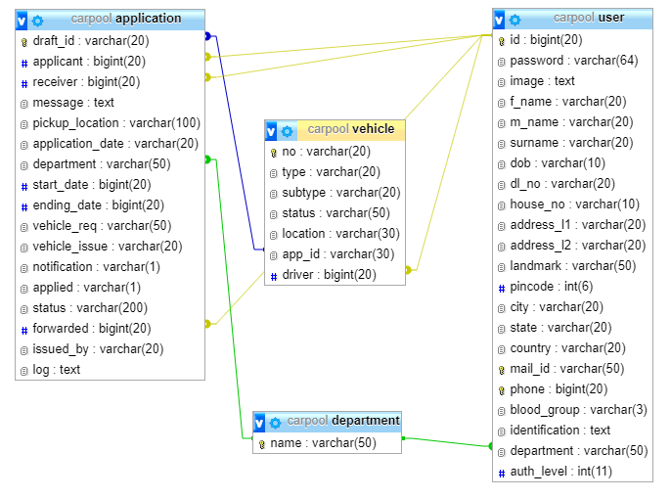
Database

Slide 6
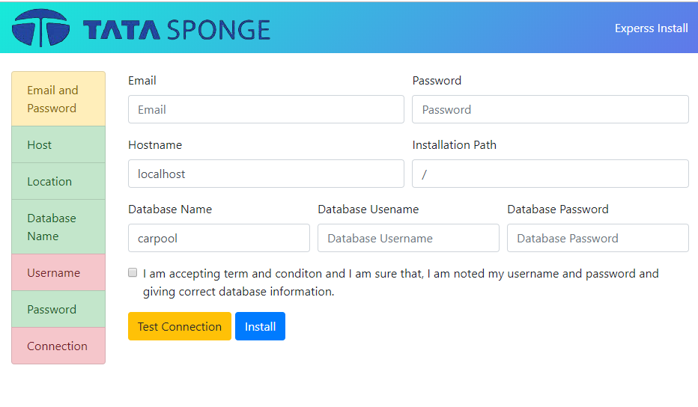
User Interface - Install
Automated Software installation at PHP MySQL server

Slide 7

Dashboard

Slide 8
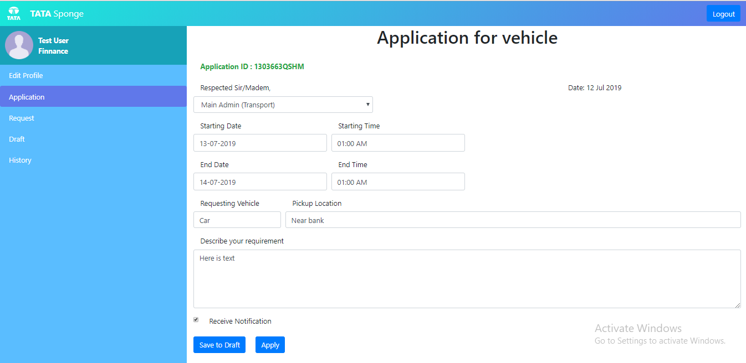
Application

Slide 9
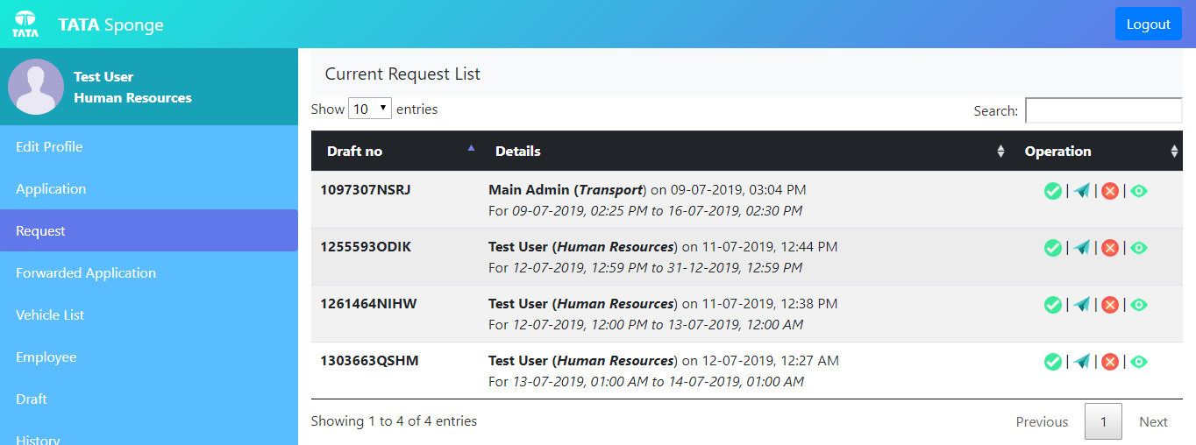
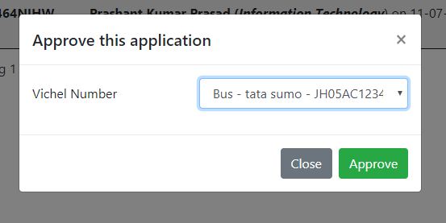
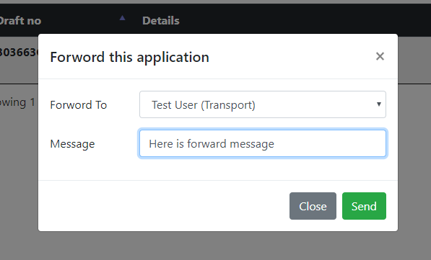
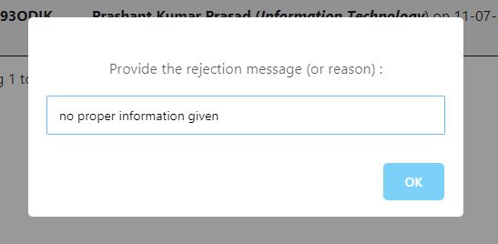
Forward and Approve

Slide 10
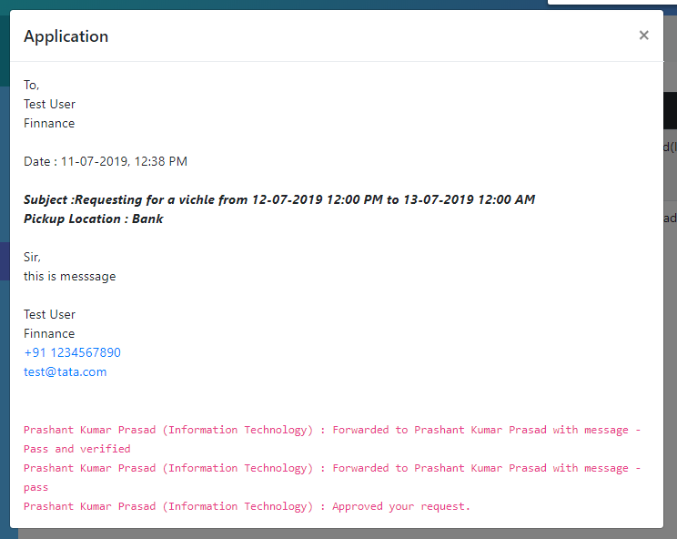
Application Status

Slide 11
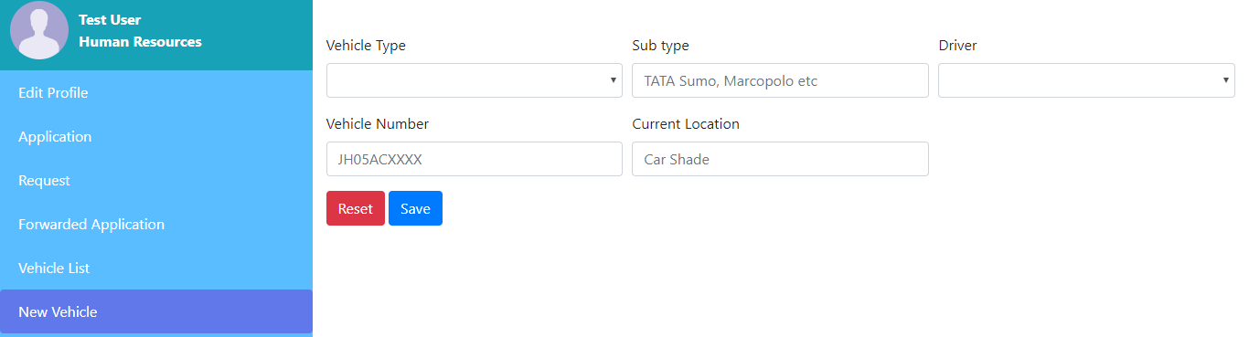
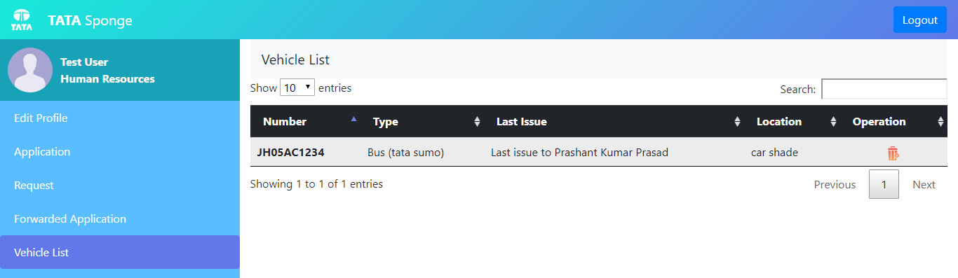
Vehicle Management

Slide 12


More questions about Internship?
Notes:
In Slide Show mode, select the arrows to visit links.

Slide 13
Thank You

